Slide 1
Disclaimer
This Financial Elder Abuse training session is primarily
for case managers and care workers
working with older people in their homes
Please note: this session will be recorded

Slide 2
Acknowledgement of Traditional Owners
Notes:
FCVic acknowledges the Traditional Owners of the lands on which our organisation is based.
We pay our respects to their Elders, past and present, and to the Elders of other Aboriginal and Torres Strait Islander communities throughout Victoria and Australia. This land was never ceded.

Slide 3
Trigger Warning
Discussing Elder Abuse may make you feel uncomfortable or triggered, please feel free to turn off your camera, take a small break or step outside for a few moments.
Referrals for assistance may include:
Your organisation’s EAP service
Beyond Blue tel: 1300 224 636
Blue Knot Lifeline tel: 1300 657 380
Lifeline tel: 13 11 14

Slide 4
Understanding financial elder abuse
Michele Padbury, Senior Financial Counsellor (VincentCare Victoria)
Lyn Dundon, Projects Coordinator (FCVic)
November 2023
Notes:
Invite participants to put their name and agency in the chat … people can see the participants from different agencies/regions.
Housekeeping
Shweta to introduce herself
Lyn & Michele to introduce themselves

Slide 5
Poll questions
1. What is your understanding of Financial Elder Abuse?
1 poor
2 reasonable
3 good
4 very good
5 excellent
2. In the last year, have you worked with clients who have experienced Financial Elder Abuse?
Yes or No
Notes:
poll questions & answers – please read a summary of the responses

Slide 6
Understanding financial elder abuse
What is elder abuse and financial elder abuse?
Who perpetrates the violence?
What does it look like for the older person?
Case Studies
How can you assist older people to seek help?
Notes:
this is what we will discuss today, and we are recording so we will share the slides with you in a few weeks time… let’s start of by hearing from the voices of older people

Slide 7
Understanding Elder Abuse
Elder abuse: Shift your perspective
Australian Human Rights Commission
YouTube link:
Notes:
We will start by viewing a short video from the Australian Human Rights Commission on Elder Abuse
What does it look like for the older person and the person using violence?
Any questions or comments after watching the video, please put them in the chat

Slide 8
Understanding Elder Abuse
The Royal Commission into Family Violence, marked a significant turning point in Victoria.
Elder abuse became widely recognised as a form of Family Violence.
Notes:
We will provide a brief overview of elder abuse and then go into more detail about financial elder abuse.
Prior to Australia’s first Royal Commission into Family Violence which was completed in 2015
Elder Abuse was regarded as an emerging issue, related primarily to ageing of the older person.
The Royal Commission into Family Violence, marked a turning point in Victoria, where elder abuse became widely recognised as a form of family violence.

Slide 9
Understanding Elder Abuse
Elder Abuse is any act that causes harm to the older person and is carried out by someone they know and trust
Notes:
Elder Abuse is any act that causes harm to the older person and is carried out by someone they know and trust.
Most cases of elder abuse is perpetrated by a family member of the older person, most commonly sons or daughters.
The older person who seeks help rarely identifies themselves as victims of elder abuse
Lyn - check in with everyone - what are the different forms of elder abuse; what does elder abuse encompass? Would you like to share your ideas in the chat?

Slide 10
Understanding Elder Abuse
Physical abuse
Sexual abuse
Psychological or emotional abuse
Social abuse
Financial abuse
Neglect
Abandonment
Notes:
Types of Abuse
Elder abuse may include physical, sexual, psychological/emotional, social or financial, abuse, as well as neglect and abandonment (Human Rights Commission, undated; Kaspiew and Carson, 2018).
Physical abuse which is any action which "…causes physical pain or injury to another person "…such as hitting, pushing or kicking (National Institute on Ageing, undated)
Sexual abuse is generally characterised as any nonconsensual sexual interaction or non-contact acts (American Psychological Association, 2021; Dean, 2019).
Psychological or emotional abuse is the infliction of emotional pain or distress (Joosten et al, 2020) which may include "...insulting or threatening a person, acts of humiliation or disrespect, and controlling behaviors including confining or isolating a person" (Dean, 2019).
Social abuse is characterised as “…preventing a person from having contact with relatives, friends, service providers and other people or restricting the person’s activities, thereby increasing their sense of isolation.” (Seniors Rights Victoria, undated). Examples include denial of access to an older person's grandchildren (2015) and restrictions on visitation (Australian Law Reform Commission, 2016).
Financial abuse is the theft or misuse of an older person's money, property or other assets, and may include taking a person's financial payments; accessing credit or bank accounts; amending a will, bank account, title to a house, or other documents, without permission (Kaspiew and Carson, 2018; American Psychological Association, 2021; Dean, 2019).
Neglect is generally defined as a failure to meet basic personal needs, such as food, water, medication, access to health care, warmth and other comfort, social and emotional needs (National Institute on Ageing, undated; Dean, 2019; Royal Commission into Aged Care Quality and Safety, 2020).
Abandonment is described by American Psychological Association (2021) as: "Desertion of an older person by an individual who has physical custody of the elder or…who has assumed responsibility for providing care to the older person".
And we know that people can experience one or more forms of elder abuse at the same time

Slide 11
Understanding Elder Abuse
Vulnerability factors for older people include living alone, being divorced or widowed, lower psychological wellbeing, poorer physical health status, greater levels of disability and greater levels of social isolation.
Notes:
With a third of all senior Australians living alone, there is a real need for assistance to alleviate loneliness and social isolation. Some older Australians face challenges and stresses associated with retirement and ageing, such as loneliness and increased social isolation, which can impact their mental health and wellbeing.
The Australian National Elder Abuse Prevalence Study in 2021, found that older people from lower socio-economic backgrounds, who were single, separated or divorced, living in rental housing, owning a house with a mortgage, have poor physical or psychological health were all features associated with being vulnerable or having a higher risk of elder abuse. December 2021 National Institute of Family Studies

Slide 12
Understanding Elder Abuse
Whilst most victims of elder abuse are women
Older men are victims in significant numbers
Notes:
Whilst most victims of elder abuse are women, older men are victims in significant numbers
Sometimes older men can be misidentified by the police, as perpetrators of elder abuse, or their anger and outbursts are a result of ill health and or dementia, when their adult children have returned and over run the family home.
In most instances elder abuse doesn’t fit easily into an intimate partner, gendered family violence model.

Slide 13
Elder abuse - who does it?
including intimate partners
intragenerational relationships (siblings)
intergenerational family relationships (parents and children, grandparents and grandchildren)
non-family relationships such as those involving professionals, carers, neighbours and acquaintances.
Notes:
Elder abuse involves a varied range of acts or omissions and a significant range of relationship types
Who does it?
People using elder abuse violence include women and men and are predominantly their adult children, a family member living with them, carer or person in a trusted relationship.
It often occurs within a parent–child dynamic (a relationship that is long–term and interdependent)
and a relationship which the older person would like to maintain.

Slide 14
Understanding Elder Abuse
There is a significant increase in the proportion of people using violence experiencing mental illness, and those with gambling or substance abuse problem
Notes:
While it doesn’t excuse the abuse, there is a significant increase in proportion of people using violence who are experiencing mental illness, and those with gambling or substance abuse problem.
Since COVID and the ongoing cost-of-living financial crisis older children and their families are moving back into their parents' home or seeking financial support from an older person to cover the costs of their own daily living expenses

Slide 15
Understanding Elder Abuse
Barriers to seeking help
Fear of repercussions
Isolation
Loneliness
Withdrawal of contact/support
Threat of not being able to see their grandchildren
Notes:
It is now largely recognised that 1 in 6 older people have experience elder abuse (Australia Institute of Family Studies Media Release Dec 2021)
Older people are often afraid to report abuse because they fear the repercussions both for themselves and for the perpetrator, usually from an adult child or other close relative.
These concerns can mean an older person endures abuse for a long time.
They may only seek help when the situation escalates to an extreme level or when someone else notices the ongoing mistreatment.
Equally important, they may fear other negative outcomes of reporting abuse.
They may fear having to leave their home and enter residential care.
They may fear increased isolation and loneliness, or that the abuse will get worse.
All these fears combined create a formidable barrier to older people promptly reporting abuse and getting the help they need.

Slide 16
Financial Elder Abuse
Theft or misuse of an older person's money, property or other assets
Notes:
Now let’s look specifically at financial elder abuse
Financial abuse is the theft or misuse of an older person's money, property or other assets, and may include taking a person's financial payments; accessing credit or bank accounts; or amending a will, bank account, title to a house, or other documents, without permission
(Kaspiew and Carson, 2018; American Psychological Association, 2021; Dean, 2019).
This could be perpetrated by family members, including grandchildren.
Examples of this include
Pressuring the older person into giving or loaning them money, possessions (jewellery) or property
Taking money, possessions or property without the older person’s permission
Not contributing to household expenses such as rent, food or household expenses while living with the older person
Pressuring the older person to make or change their will
Making financial decisions for the older person without their permission

Slide 17
Understanding Financial Elder Abuse
The Australian Banking Association has acknowledged the need to train bank staff to understand the red flags that indicate an older person may be experiencing financial elder abuse and the importance of referral for support including to a financial counsellor
Notes:
the CEO of ABA Anna Bligh said Australian banks see first hand the impacts of elder abuse and have put in place key initiatives to assist with its prevention.
“The banking sector is training staff and using software to recognise warning signs of elder abuse such as red flags on transactions,”
Banks acknowledge common warning signs of financial abuse can include:
unusual transactions after giving someone authority to access their account
missing or confusing bank statements
withdrawals from the account that don’t make sense
feeling pressured to give someone access to their account or pin number
feeling pressured to make changes to a will, power of attorney or legal document
feeling intimidated or controlled by another person.
Banks are providing tools to help customers manage accounts, such as pre-set digital banking, transaction limits, notifications and two to signature arrangements.
Banks are also referring customers for internal and external support such as specialised customer assistance and financial counselling.

Slide 18
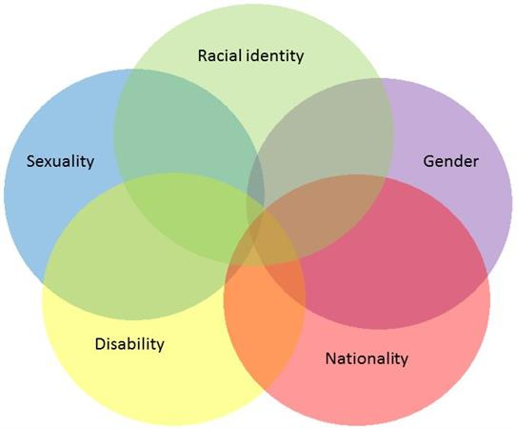
Understanding Elder Abuse
Notes:
You may want to consider using an intersectional lens when working with people, including older people
Consider a person’s racial identity, nationality, sexuality, gender and disability
How this may affect the elder abuse they are experiencing
And help the older person identify the abuse, and seek help
Diagram: Womankind intersectionality-101 November 2019

Slide 19
Questions & Comments
What are the red flags you may want to consider that indicate an older person is in financial stress?
Notes:
Your work to support older people living in their home is invaluable and contributes to having more eyes on the older person and their circumstances as they age in place.
What are the red flags you may want to consider that indicate an older person is in financial stress?
Please either enter your comments in the chat or unmute and share your ideas?
Signs to look out for Financial Stress
> Presenting to a service for emergency relief – if someone is seeking emergency relief, financial or material aid, it’s usually a good indication that they are finding things tough at the moment.
> Overdue bills or payments – if someone has mentioned trying to keep on top of their bills, or you’ve
identified that they are late making a payment, they could benefit from speaking to a financial counsellor.
> Skipping meals or stopped using heating or cooling –it can be used as a way of making money go further. This also applies to households that have stopped using their heating or cooling in order just to have enough money.
> Avoidant behaviour – unopened mail and unanswered calls can be a sign of financial stress and money
worries.
> Family has moved in – this can have an impact on the household expenses, especially if the additional
people are not contributing towards those costs.
> Indications that the person has been excluded from financial decisions – if someone is unaware of
certain financial matters that affect them, or they are unhappy with a financial decision that has been made, it can be an indication that there is financial abuse present.

Slide 22
Questions & Comments
What phrases might we use to start a conversation with an older person about financial elder abuse?
Notes:
What phrases might we use to start a conversation about financial elder abuse with an older person?
Family Violence, Elder Abuse and Financial Elder Abuse are difficult conversations to have with older people.
Please either enter your comments in the chat or unmute and share your ideas?
Simple “yes/no” questions are an easy way to get an idea of someone’s situation without them having to go into detail:
> “Are there any bills that you’re worried about?”
> “Do you have enough money for what you need (food, medicine, heating/cooling, rent)?”
Use relatable anecdotes to de stigmatise financial hardship and reassure someone that they are not alone:
> “I’ve spoken to a lot of people who are finding it hard to keep on top of their bills at the moment. How are you coping?”
> “My kids have moved back in to help out, but they’re eating me out of house and home. What’s it been like for you?”

Slide 23
Support for vulnerable people in financial hardship
Financial Counselling Services in Victoria
https://fcvic.org.au/get-help/
National Debt Helpline – talk to a financial counsellor and referral to local financial counselling agency 1800 007 007
Notes:
Financial counselling is free, confidential and non-judgemental for people at risk or experiencing financial hardship; financial counsellors work in local community agencies across Victoria
what does a FC do? Assess/options/actions

Slide 24
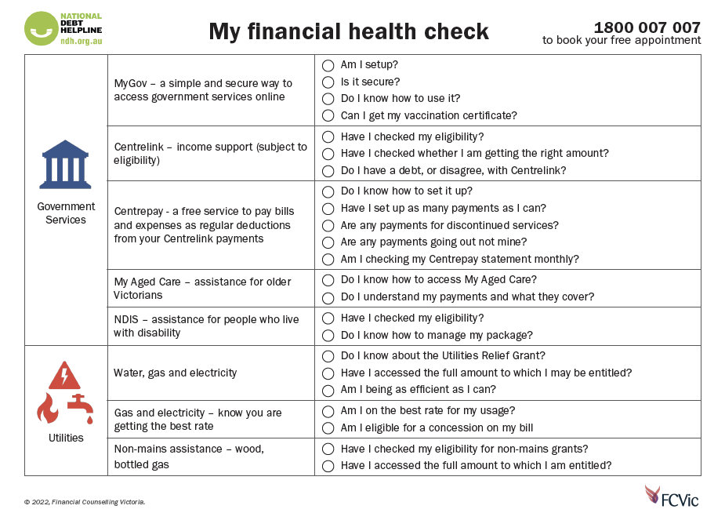
My Financial Health Check
Notes:
FCVic has produced this resource which you can use with older people as a soft entry conversation into financial hardship and elder abuse

Slide 25
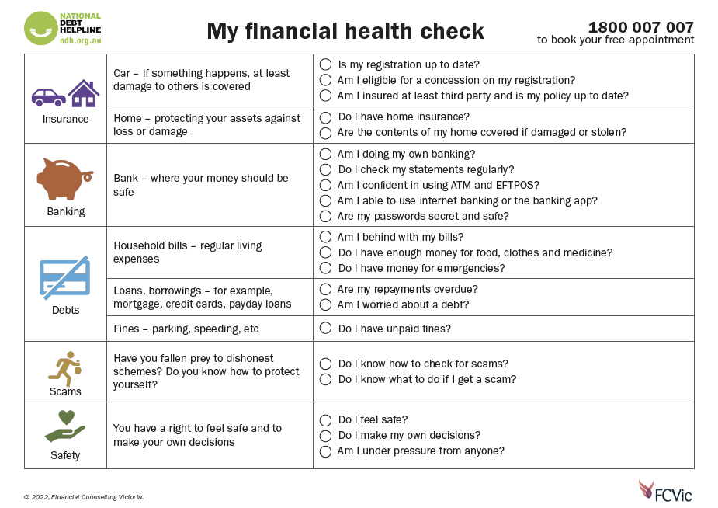

Slide 26
Resources
Seniors Rights Victoria Helpline 1300 368 821 https://seniorsrights.org.au/about-us/contact-us/
Office of the Public Advocate 1300 309 337
https://www.publicadvocate.vic.gov.au/
Social Security Rights Victoria
Rural Callers 1800 094 164
Worker Helpline 9481 0655
https://www.ssrv.org.au/contact-us/
Dementia Australia 1800 699 799 https://www.dementia.org.au/
Notes:
SRV is a statewide community legal service providing integrated model of case work support (lawyers & advocates) for older people experiencing elder abuse. The statewide helpline is for older people, secondary consults for workers and family and friends who want advice.
SSRV is a statewide community legal service working to support clients who have difficulties with the social security system. It may be advantageous for the older person to seek advice about gifting or deeming before making decisions which may not be advantageous to them.
The Office of the Public Advocate has a helpline and a range of fact sheets from making a PoA, advance care directive, guardianship and administration. OPA also run regular online information sessions.
Dementia Australia provides information and resources to understand the impact of dementia and decision-making capacity

Slide 27
EAAA & COMPASS
Elder Abuse Action Australia (EAAA)
EAAA is a specialist organisation acting to eliminate elder abuse. Working positively to impact the lives of older Australians, their families, communities and broader society.
https://eaaa.org.au/about-us/
https://www.compass.info/about/
Notes:
If you go to the EAAA COMPASS website you can find resources, videos, case studies, literature reviews, articles and fact sheets about future planning, family agreements, supported decision making, PoAs, coercive control, dementia – it’s a one stop shop for elder abuse resources

Slide 28
Evaluation Poll
1. Overall I found this session to be
Very Satisfactory
Satisfactory
Neutral
Unsatisfactory
Very Unsatisfactory
2. Please tell us why you gave this rating
in the zoom chat

Slide 29
This Photo by Unknown Author is licensed under CC BY-NC

